Slide 1
Moving averages
Source: StockCharts.com >> Chart School
>> Technical Indicators and Overlays
>> Moving average
Presenter: Tsung-Jung Tsai (蔡宗容)
Date: Oct. 24, 2007

Slide 2
Introduction
Moving average (移動平均線) are one of the most popular and easy to use tools available to the technical analyst. They smooth a data series and make it easier to spot trends, something that is especially helpful in volatile markets. They also form the building blocks for many other technical indicators and overlays.
Notes:
移動平均線對技術分析師而言，是一種最受歡迎且容易使用的工具之一。移動平均線把一序列的資料平滑化，使它容易看出趨勢，有時候在變幻莫測的市場中特別有用。它們對很多的技術指標和套疊構成了建構基礎(建構模子)。

Slide 3
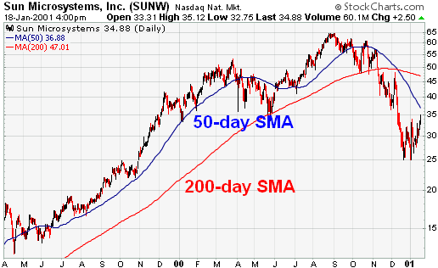
The two most popular types of moving averages are the Simple Moving Average (SMA) and the Exponential Moving Average (EMA)

Slide 4
MA Specification
Input:
A series of data <x1, x2, x3, …, xn-1, xn> and
the length of the period T
Process:
Calculate the simple moving average (SMA) and the exponential moving average (EMA), respectively.
Output:
A series of smooth data <xT, xT+1, xT+1, …, xn-1, xn>

Slide 5
Simple moving average (SMA)
A simple moving average is formed by computing the average (mean) price of a security (證劵) over a specified number of periods.
The price can be opening, high, low, and closing price.
Notes:
移動平均線是藉由計算一證劵的平均價格。它可能由開盤價、最高價、最低價或是收盤價來建立移動平均線。大部分的移動平均線是採用收盤價來建立。

Slide 6
Example
A 5-day simple moving average (5日的簡單移動平均線) is calculated by adding the closing prices (收盤價) for the last 5 days and dividing the total by 5.
10 + 11 + 12 + 13 + 14 = 60
the last 5 days
time : t
(60 / 5) = 12

Slide 7
10 → 11 → 12 → 13 → 14 → 15
added
10 +
11 + 12 + 13 + 14 + 15 = 65
the last 5 days
dropped
time : t + 1
(65 / 5) = 13

Slide 8
10 → 11 → 12 → 13 → 14 → 15 → 16
added
11 +
12 + 13 + 14 + 15 + 16 = 70
the last 5 days
dropped
time : t + 2
(70 / 5) = 14

Slide 9
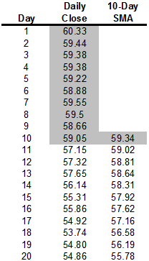
As the calculation continues, the newest day is added and the oldest day is subtracted.

Slide 10
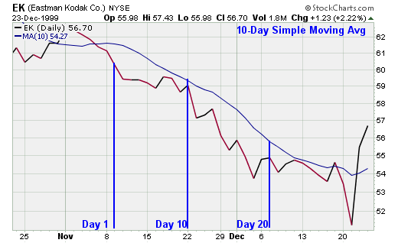

Slide 12
Exponential Moving Average (EMA)
In order to reduce the lag in simple moving averages, technicians often use exponential moving averages (also called exponentially weighted moving average).
EMA’s reduce the lag by applying more weight to recent prices relative to older prices.
It will react quicker to recent price changes than a simple moving average.
Notes:
exponential moving averages (also called exponentially weighted moving average)

Slide 13
Formula for an EMA
EMA( t )
= EMA( t – 1) + ( Price( t ) – EMA( t – 1 )) x Multiplier
EMA( t )
= EMA( t – 1) x ( 1 – Multiplier) + Price( t ) x Multiplier
Multiplier = 2 / ( 1 + N)
where N is the specified number of periods.

Slide 14
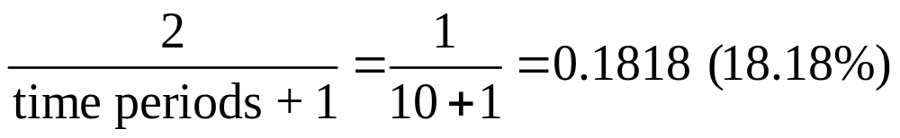
Example
A 10-period EMA’s Multiplier is calculated like this:
Weight：
EMA( t – 1)
Price( t )
18.18%
81.82%

Slide 15
EMA can be specified in two ways
As a period-based EMA
ex. 10-period EMA
As a percent-based EMA
ex. 18.18% EMA
In the above examples, they are equivalent.

Slide 16
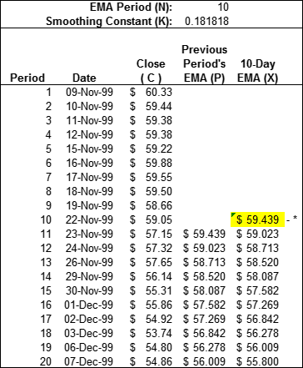
C × 18.18%
= 57.15 x 0.1818
= 10.390
P × 81.82%
= 59.439 x 0.8182
= 48.633
C × (1 – K)+P × K
= 48.633 + 10.390
= 59.023
10-period SMA
( Initial value)

Slide 17
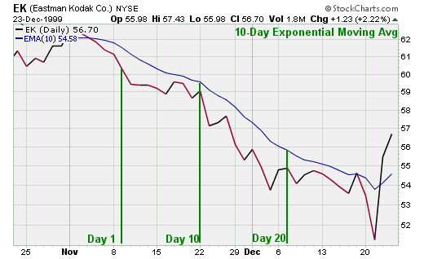

Slide 19
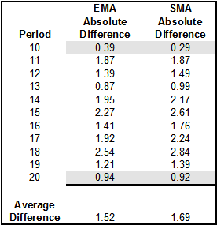
Simple versus Exponential
EMA absolute difference
= | EMA( t ) – price( t )|
SMA absolute difference
= | EMA( t ) – price( t )|
The exponential moving average is consistently closer to the actual price (實際價格).

Slide 20
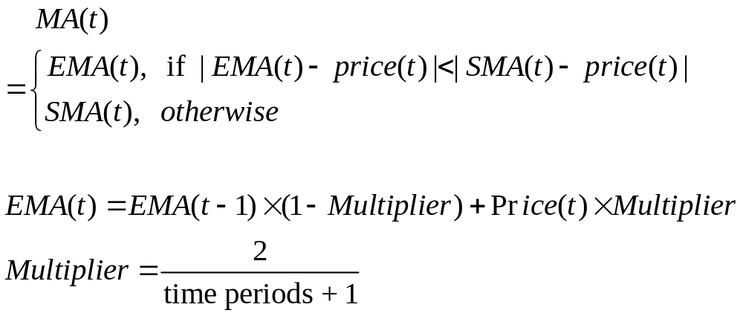
Our idea

Slide 21
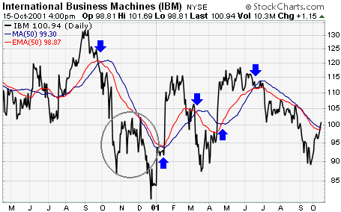
A comparison of a 50-day EMA and a 50-day SMA for IBM

Slide 22
Which is better?
Depend on your trading and investing and preferences.
The SMA obviously has a lag, but the EMA may be prone to quicker break.
Some traders prefer to use EMA for shorter time periods to capture changes quicker.
Some investors prefer SMA over long time periods to identify long-term trend changes.

Slide 23
When to use
In its simplest form, a security’s price can be doing only one of three things:
  Trending up
  Trending down
  Trading in a range
A uptrend is established when a security forms a series of higher highs and higher lows.
A downtrend is established when a security forms a series of lower lows and lower highs.
A trading range is established if a security cannot establish an uptrend or downtrend.

Slide 24
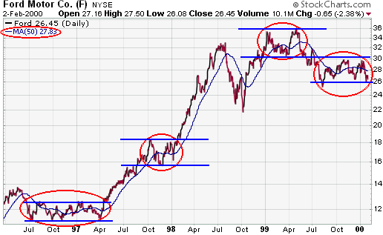

Slide 25
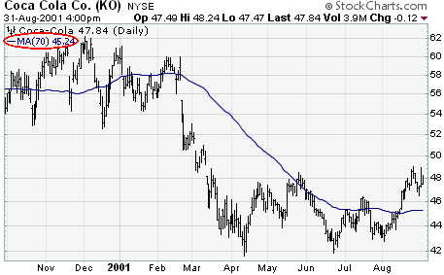

Slide 26
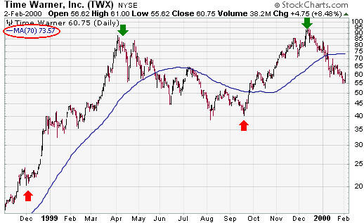

Slide 27
Uses for moving averages
There are many uses for moving averages, but three basic uses stand out:
  Trend identification/confirmation
  Support and Resistance (支撐 & 壓力) level identification/confirmation
  Trading Systems

Slide 28
Trend identification/confirmation
The first trend identification technique uses the direction of the moving average to determine the trend.
If the moving average is rising, the trend is considered up.
If the moving average is declining, the trend is considered down.

Slide 29
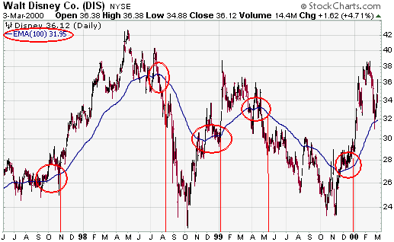
Trend Identification/Confirmation

Slide 30
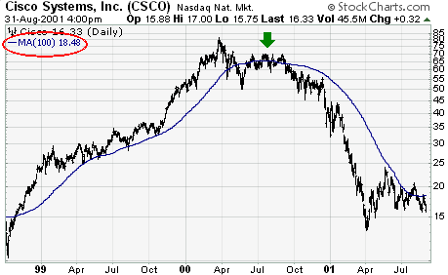
There was a brief sell signal generated in Aug-99 and a false buy signal in July-00

Slide 31
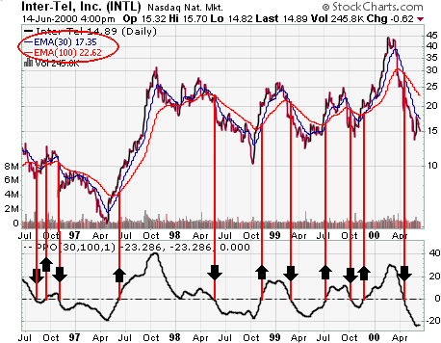

Slide 32
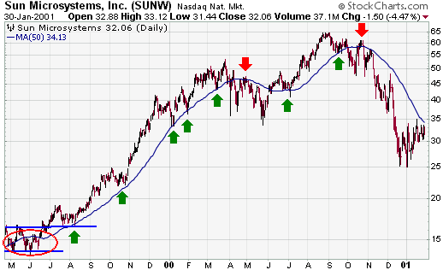
Support and Resistance Levels

Slide 33
Conclusion
Moving averages can be effective tools to identify and confirm trend, identify support and resistance levels, and develop trading systems.
Traders and investors should learn to identify securities that are suitable for analysis with moving averages and how this analysis should be applied.
Don't expect to get out at the top and in at the bottom using moving averages.

Slide 34
As with most tools of technical analysis, moving averages should not be used on their own, but in conjunction with other tools that complement them.
Using moving averages to confirm other indicators and analysis can greatly enhance technical analysis.

Slide 35
Another tool
The ADX, Average Directional Index, is one tool that can help identify securities that are trending and those that are not.

